Slide 1
Quality standards
The Case for quality: The (chaordic) path to youth and family engagement standards in Ontario
Mary Ann Notarianni
October 24, 2019
Melbourne, Australia

Slide 2
Introductions

Slide 4
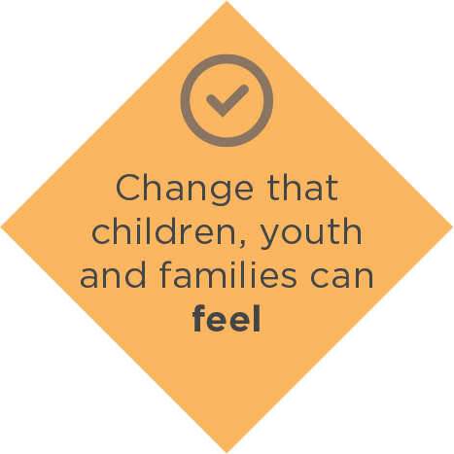
About the Centre
Notes:
Formal intro of the Centre – general about us
The Ontario Centre of Excellence for Child and Youth Mental Health is funded by the provincial government to channel the momentum for change in child and youth mental health into practical initiatives that will improve service access, experience and outcomes in every community. Together with our partners, we will set the standard for child and youth mental health services and stand up for an evidence-informed system that makes a real-life difference for people across Ontario.
We do this by working together with youth and families, stakeholders and cross-sectorial partners to mobilize evidence and generate knowledge in key areas of child and youth mental health.

Slide 5
Notes:
Formal intro to Centre – Mission and values; strategic directions

Slide 6
Agenda
The (chaordic) path to youth and family engagement in Ontario
The case for quality
Implementation, evaluation and next steps
Q&A

Slide 7
Before we begin…
Notes:
Housekeeping

Slide 8
Let’s get to know each other

Slide 9
Goals for today
Describe efforts to grow capacity for youth and family engagement in Ontario’s child and youth mental health sector
Set the context for, and introduce the quality standard for youth engagement and the quality standard for family engagement
Understand how implementing a quality standard helps facilitate youth and family engagement, particularly at a system level

Slide 10
The (chaordic) path to youth and family engagement in Ontario

Slide 12
Youth is…
A developmental transition; a fluid notion depending on context rather than a fixed age-group. Youth may be defined differently by funders, cultures, organizations, communities and self.
Notes:
This definition was co-developed with youth and Centre standard advisory committee.

Slide 13
Family is…
A circle of care and support that offers enduring commitment to care for one another, and is made up of individuals related biologically, emotionally, culturally or legally. This includes those who the person receiving care identifies as significant to their well-being.
Notes:
This definition of family was co-created by family members and service providers during the development of the family engagement standard and using the literature.
Diversity is an important component of what a family is. Each family has its own culture, with norms and structure. Family engagement can be more meaningful when agencies and people are more

Slide 14
Shifting paradigms
I dream my painting then I paint my dream, 2005, Youth Art Mural Camp, Ottawa, ON

Slide 19
Embedding an implementation science approach

Slide 20
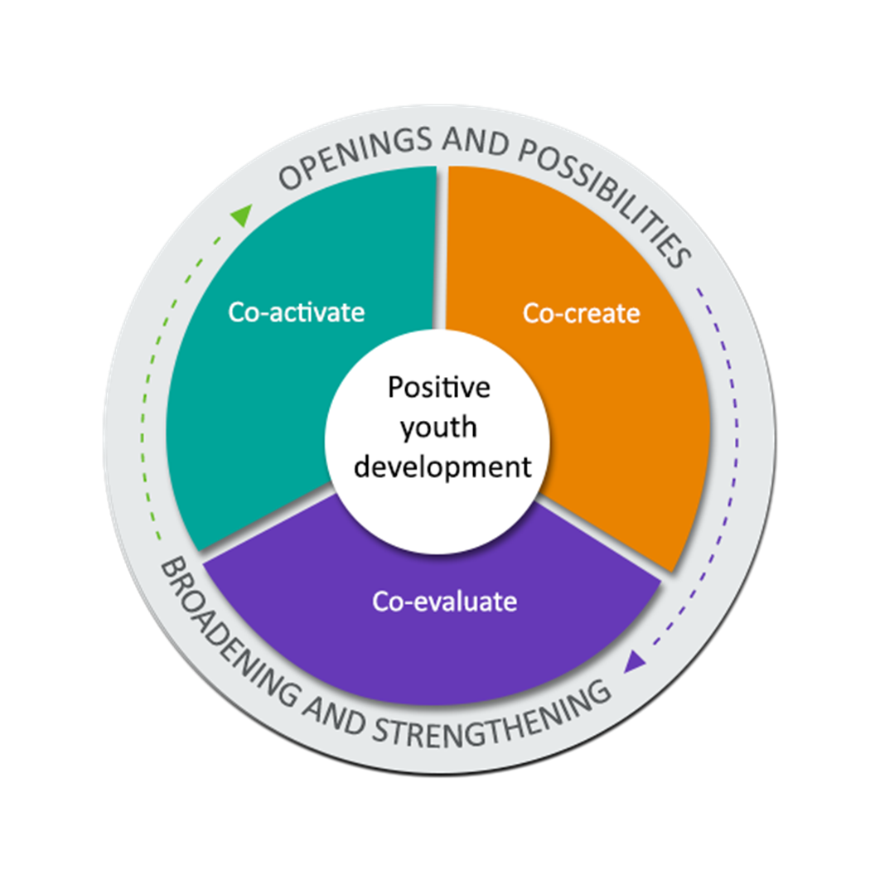
The Centre’s YE framework
Positive relationships
Positive spaces
Positive opportunities

Slide 21
The Centre’s FE model

Slide 22
Defining engagement

Slide 23
Youth engagement…
Empowers youth as valuable partners in child and youth mental health to address and make decisions that affect them personally and/ or they believe to be important.

Slide 24
Family engagement is…
An ongoing process that includes families as active decision-makers and partners at the organizational and system levels.
Notes:
Clarify this is def’n used for standard. Still engagement in treatment…

Slide 25
Engagement occurs at many levels
personal care and health decisions
organizational level
system-level

Slide 26
Continuum of engagement

Slide 27
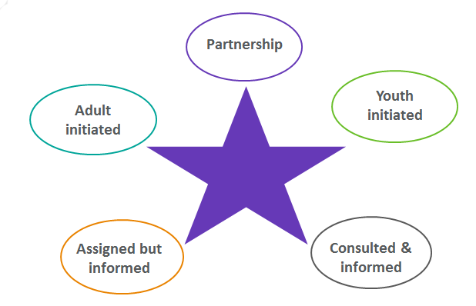
Star of youth engagement*
Tokenism
Manipulation
Decoration
*adapted from Hart’s Ladder of Youth Participation

Slide 28
Hart’s ladder - adapted for family engagement
Partnership
Co-development
Consulted
Informed
Tokenism
Decoration
Manipulation

Slide 29
Activity

Slide 30
Engagement amidst system change

Slide 31
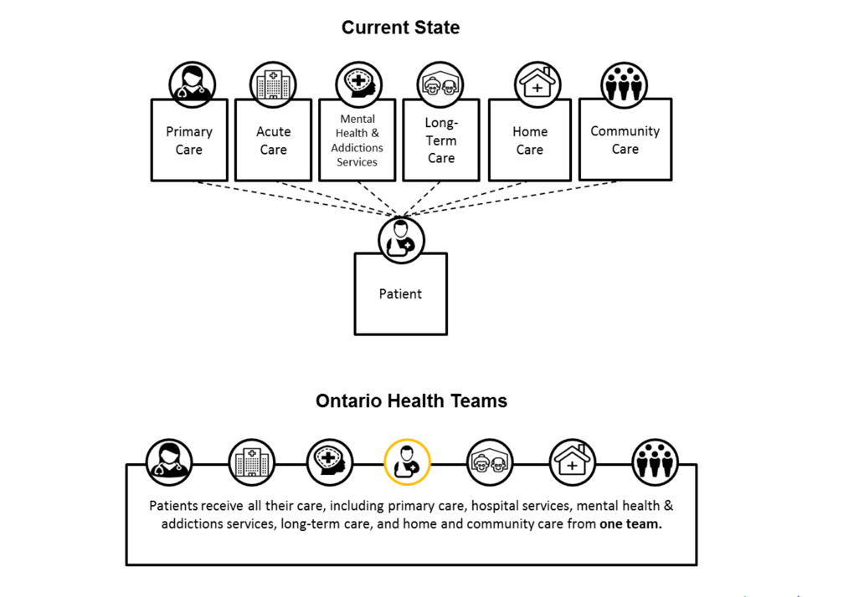
2018: Conservative party in power after 15 years of Liberal gov’ts
2012:
CYMH system transformation
2019:
Health system transformation

Slide 32
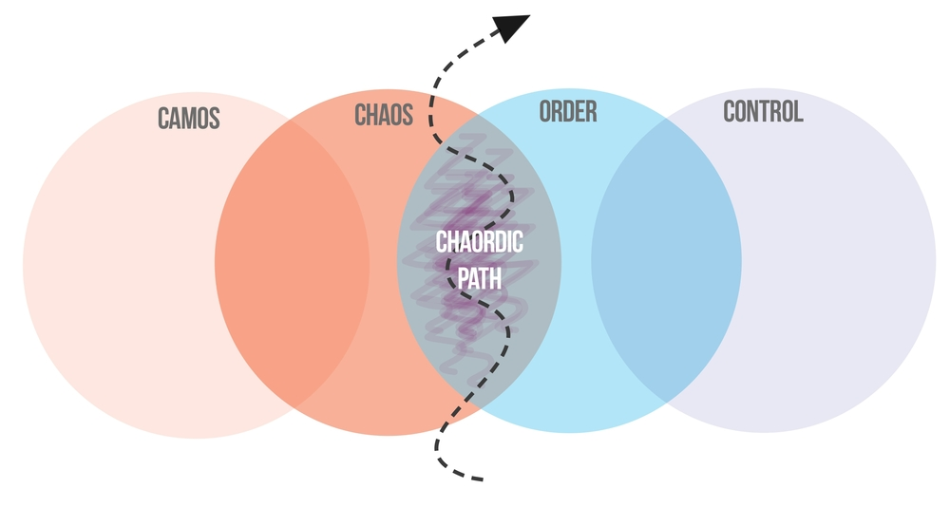
The chaordic path
Zand Craig, Art of Hosting

Slide 33
Where we’re headed

Slide 34
The case for quality

Slide 35
Overview of quality

Slide 36
Quality and outcomes
Quality of care and services
Outcomes for children, youth and families
Notes:
It is safe to say, that everyone here has a keen interest in improving child and youth mental health outcomes and are very aware that providing quality services plays key role in the positive outcomes for children, youth and families within the mental health and addiction services

Slide 37
Dimensions of quality care
Areas, domains or aims for ensuring quality health care services.
QUALITY CARE
client focused
efficient
effective
equitable
timely
safe
Institute of Medicine, 2001

Slide 38
What does quality look like in your context?

Slide 39
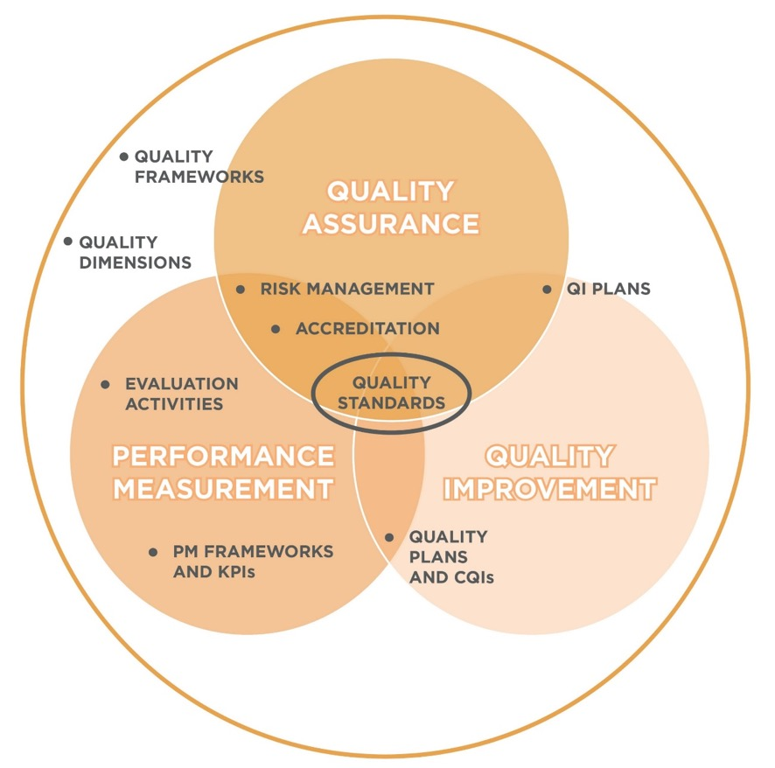
Frequently used terms

Slide 40
Quality assurance
helps ensure programs and services meet established standards (e.g. accreditation standards, professional practice guidelines and health and regulatory requirements).
includes all planned and systematic activities implemented in a quality system so that quality requirements for a product or service will be fulfilled.
American Society for Quality, 2016

Slide 41
Quality improvement
helps ensure programs and services continue to improve, innovate and evolve for optimal outcomes for children, youth and families.
includes “…all actions taken throughout the organization to increase the effectiveness and efficiency of activities and processes in order to provide added benefits to both the organization and its customers”.
Council on Accreditation, in the Ontario Welfare Quality Network, 2009

Slide 42
Performance measurement
helps ensure strategic priorities and targets are being met.
refers to “the regular collection of information for monitoring how a policy, program or initiative is doing at any point in time”.
Treasury Board of Canada

Slide 43
Quality requires all three
Quality improvement
Performance measurement
Increased risk
Quality assurance
Performance measurement
Status quo
Quality assurance
Quality improvement
Lack of strategic focus
Quality assurance
Quality improvement
Performance measurement
Quality

Slide 44
Quality standard
collection of quality statements, or principles, that describe what high quality care looks like, based on evidence
includes best practices and indicators to show progress, or the impact of these practices
essential for a system that is accountable and constantly improving
Notes:
Quality standards are concise sets of evidence-based, measurable statements that provide guidance on important elements of high quality care in a specific topic area” HQO, 2017.​
​
Quality standards are essential to a system that is accountable and constantly improving. They are also central to ensuring that Ontario children, youth and families access and receive consistent high-quality mental health services wherever they are within the province.

Slide 46
Why a quality standard?
ensures consistent practices or processes for family and youth engagement
formalizes engagement processes
validates the lived experience of families and youth who engage in system level efforts
provides a baseline of measurement across the province where one did not exist
challenges us as a sector to continue to improve

Slide 47
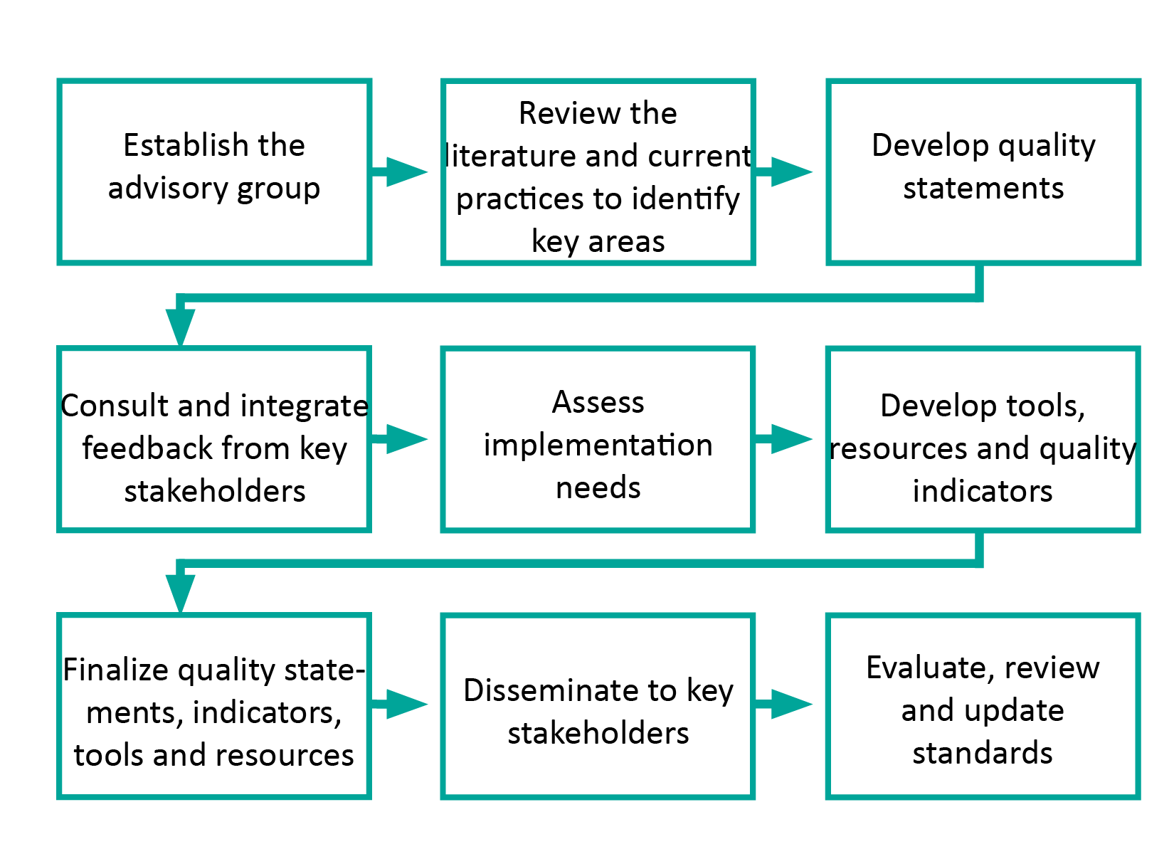
Development process
Adapted from Health Quality Ontario, 2016

Slide 48
Introducing our engagement quality standards

Slide 49
Quality standard for youth engagement

Slide 50
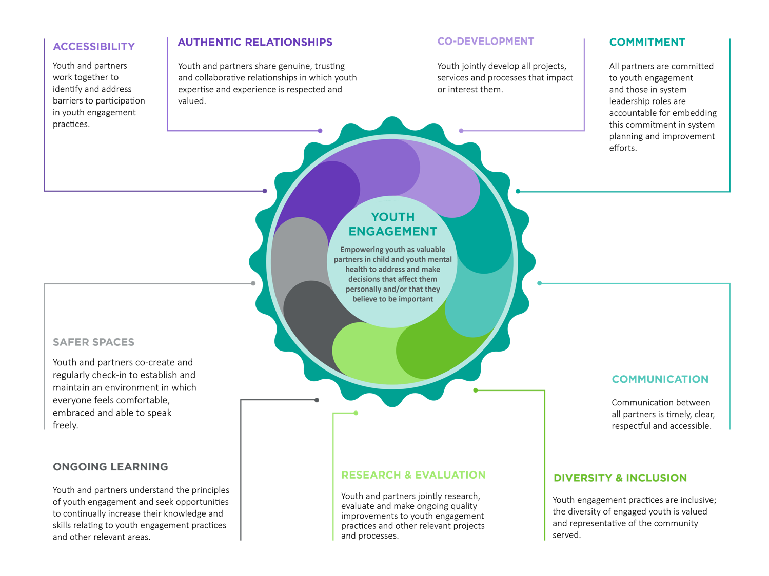

Slide 51
Authentic relationships
Youth and partners share genuine, trusting and collaborative relationships in which youth expertise and experience is respected and valued.
What this means for…
Youth
You are treated as an equal partner in engagement initiatives. Your expertise is valued, and you have a voice in decisions that impact you. You understand how decisions are being made and how your expertise is being used to guide them.
Agencies
You treat and value youth as equals partners. You formally define roles together and follow them, ensuring your organization’s decision-making processes are transparent.
System decision-makers
You collaborate with youth when developing policies that impact them. You value their expertise and include their perspective. You are transparent, ensuring youth understand how decisions are being made and how their expertise is being integrated.

Slide 52
Quality standard for family engagement

Slide 53
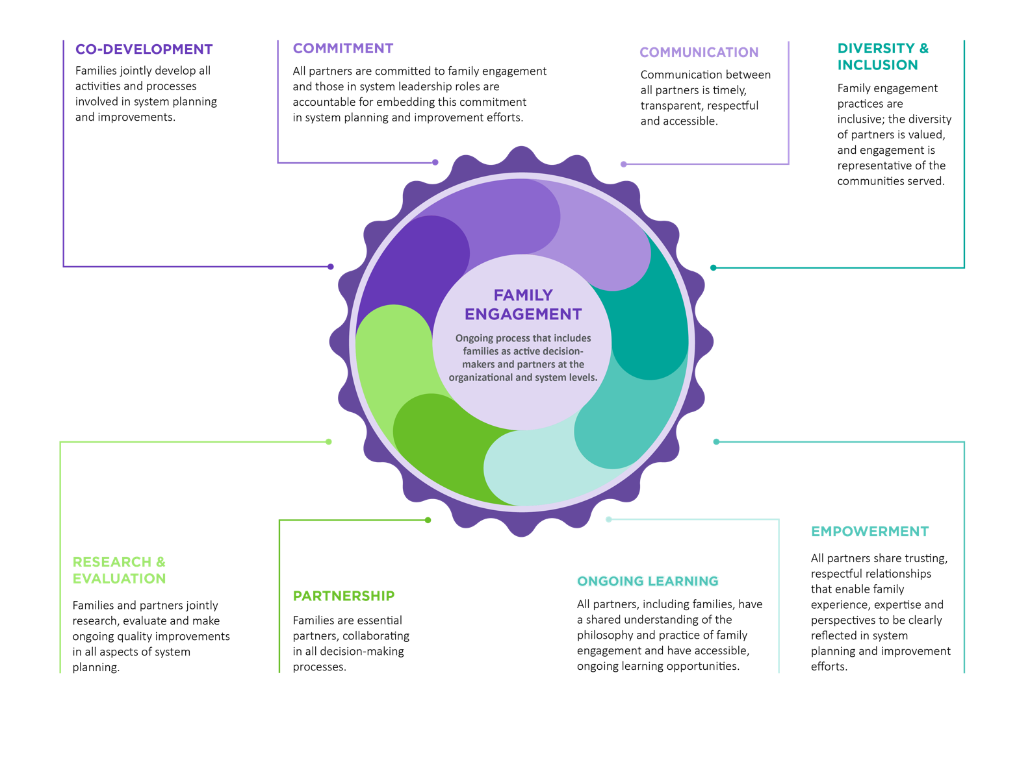

Slide 54
Commitment
All partners are committed to family engagement and those in system leadership roles are accountable for embedding this commitment in system planning and improvement efforts.
What this means for…
Families
Your perspectives are equally valued and consistently embedded at the organizational and system levels.
Agencies
Family engagement principles are built into organizational policies, processes and activities. Leaders exemplify their commitment in strategy and resource allocation.
System decision-makers
You treat family engagement as essential, not optional. You plan and allocate funds in a way that ensures family voice is integrated into the mental health system.

Slide 55
Exploring the standards

Slide 56
Exploring the standards
How could you implement this quality component in your setting (think organizational or system)?
What would help you implement it? Sustain it?
How can you overcome any barriers to implementing this component of engagement?

Slide 57
Implementation, evaluation and next steps

Slide 58
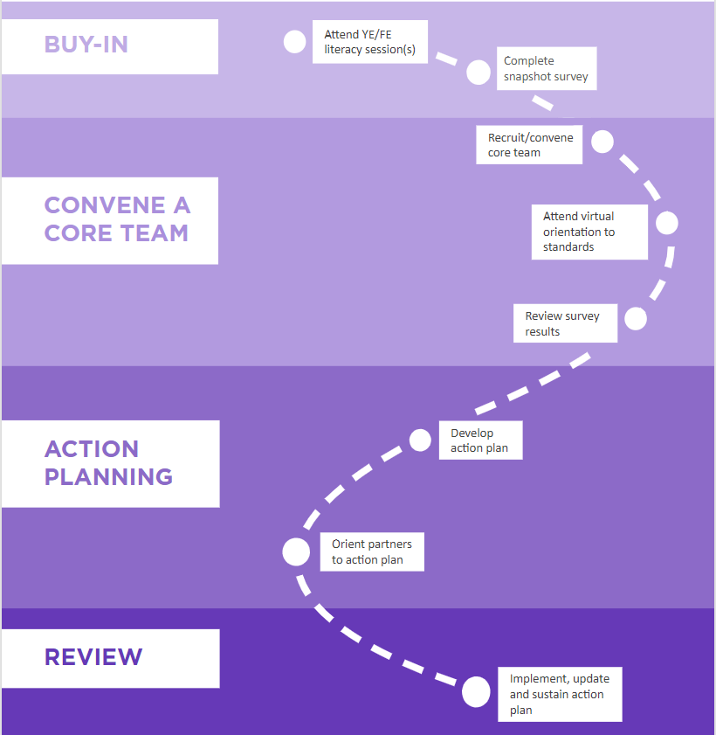
Coaching process

Slide 59
Relevant evaluation approach
Principles-focused evaluation by Michael Quinn Patton (2017):
Context is dynamic and complex
Useful for evaluating non-traditional programs and systems change

Slide 60
Measuring quality
Snapshot surveys for each standard
Different versions depending on respondent
Completed at the beginning (prior to any YE or FE literacy training and every year)
Arranged by quality statement
2 items + 1 open-ended question per statement
Total items: 16-24 (FE), 18-27 (YE)
Includes questions on YE or FE overall and open-ended questions

Slide 61
Sample FE question

Slide 62
Sample YE question (staff version)

Slide 63
Next steps
Soliciting feedback on standards and measurement tool
Learning from process evaluation
Hard launch and mobilization in Spring 2020
Focus on spread and scale

Slide 64
Final thoughts
In an era of significant system changes, the case for engagement is stronger than ever.
Engagement is key to quality in the mental health system.
Engagement needs to be embedded and sustained. We believe measurable quality standards will help.
Small improvements can make a big difference.
The process is the practice.

Slide 65
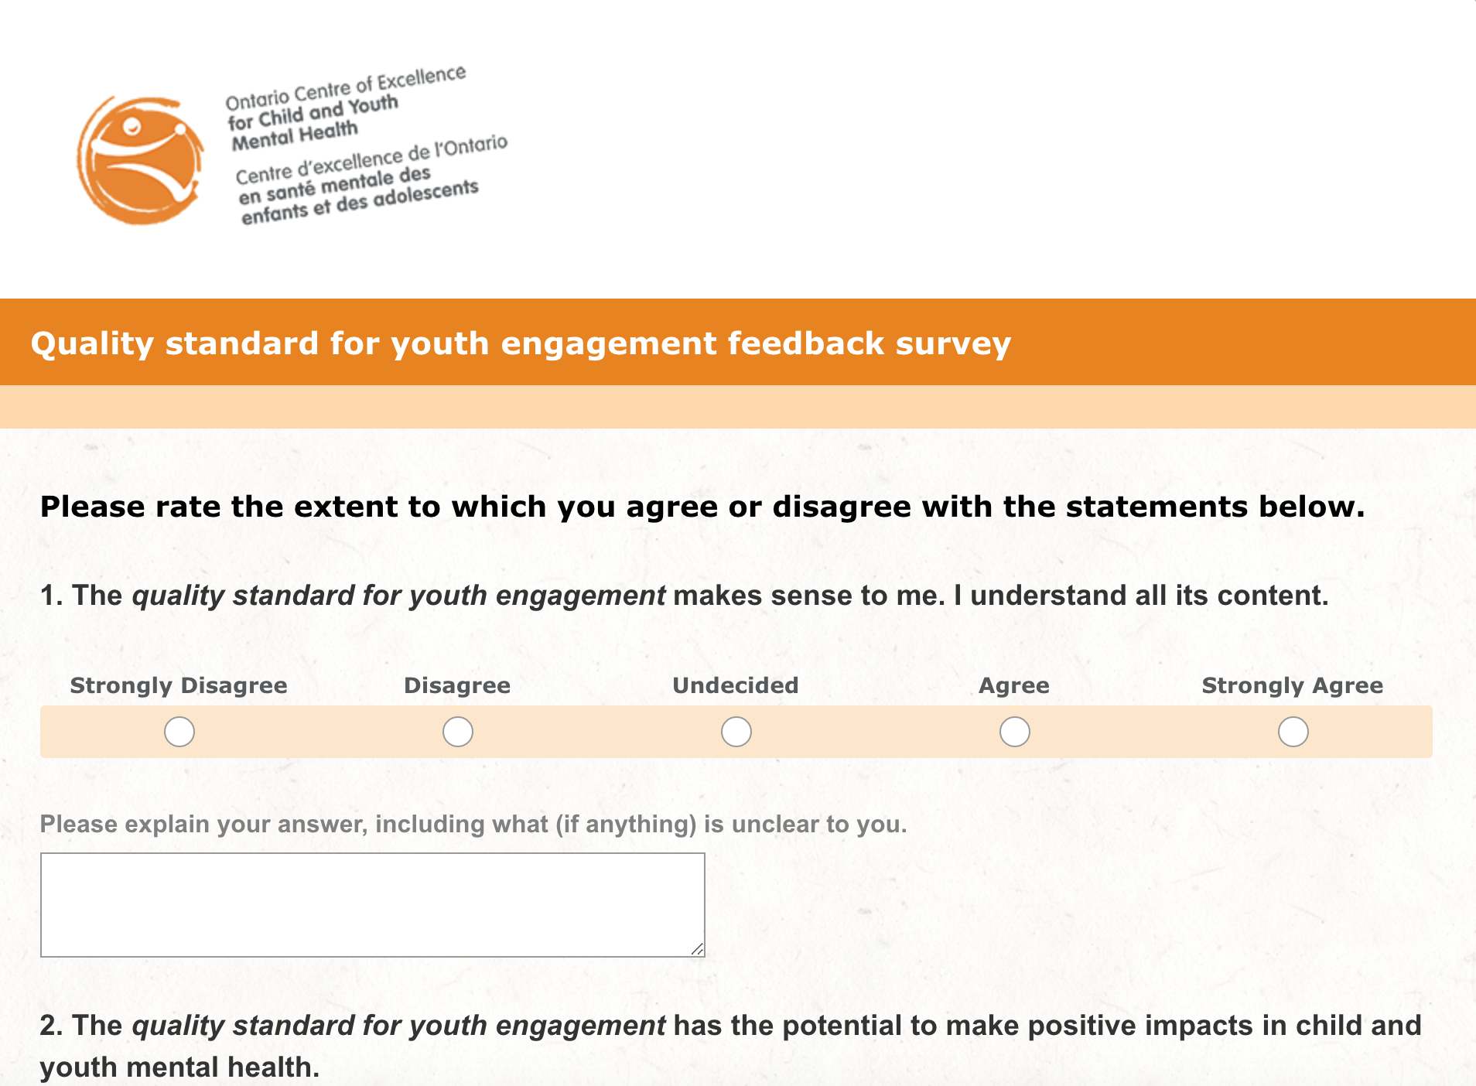
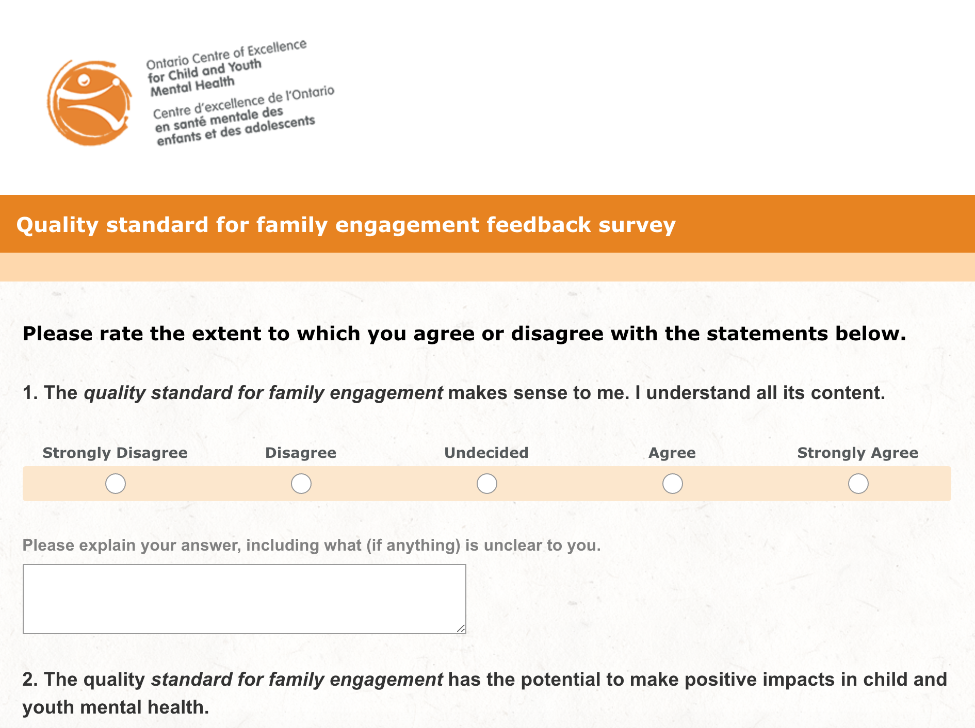
Share your feedback
Contact cymhstandards@cheo.on.ca
Review the standards and complete our short online surveys: bit.ly/2mXZjN9

Slide 66
Contact us
mnotarianni@cheo.on.ca
excellenceforchildandyouth.ca
@CYMH_ON

